Slide 1
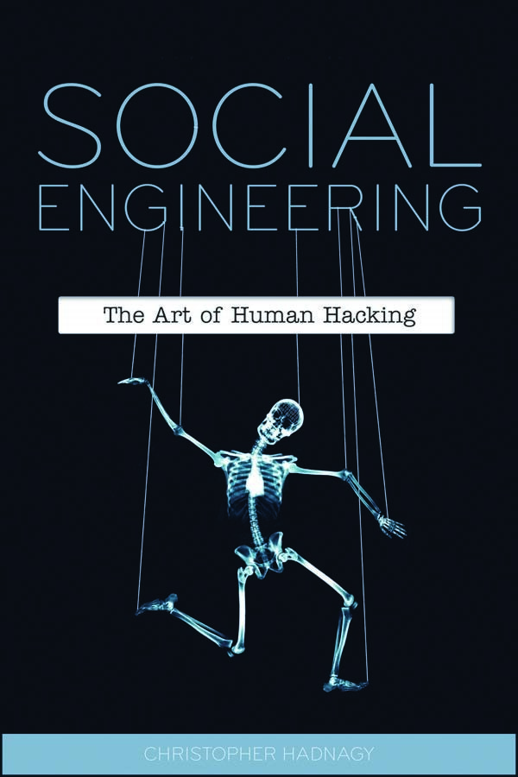
“Social Engineering: The Art of Human Hacking” - the book I have read that reveals and dissects the technical aspect of many social engineering maneuvers. From elicitation, pretexting, influence and manipulation all aspects of social engineering are picked apart, discussed and explained by using real world examples, personal experience and the science behind them to unraveled the mystery in social engineering.
It examines social engineering, the science of influencing a target to perform a desired task or divulge information.
Book arms you with invaluable information about the many methods of trickery that hackers use in order to gather information with the intent of executing identity theft, fraud, or gaining computer system access.
It reveals vital steps for preventing social engineering threats.

Slide 2
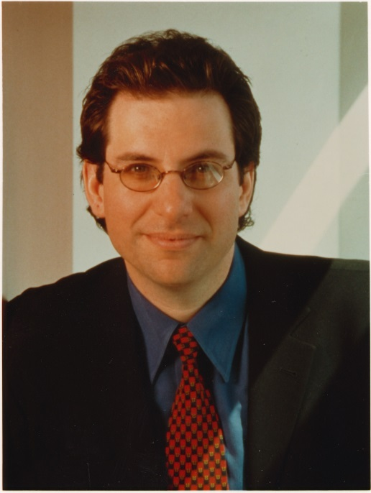
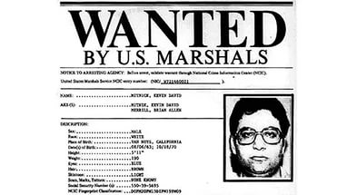
Regarding real-world examples: the book describes the story of Kevin Mitnick - one of the most famous social engineers in the world—popularized the term “social engineering.” He explained that it is much easier to trick someone into revealing a password for a system than to exert the effort of hacking into the system. Mitnick claims that this social engineering tactic was the single-most effective method in his arsenal. This indispensable book examines a variety of maneuvers that are aimed at deceiving unsuspecting victims, while it also addresses ways to prevent social engineering threats. At the end of the 20th century, he was found guilty of various computer and communication crimes. In 1980, Mitnick makes his first hack - a school local area network. A little later, while studying at the University of Los Angeles, Kevin hacked into a university computer, from which the Pentagon had already been attacked, as a result of which the young social engineer got the code of the intercontinental station and several other documents marked “Secretly“. Mitnick was caught and sentenced to six months in prison.

Slide 3
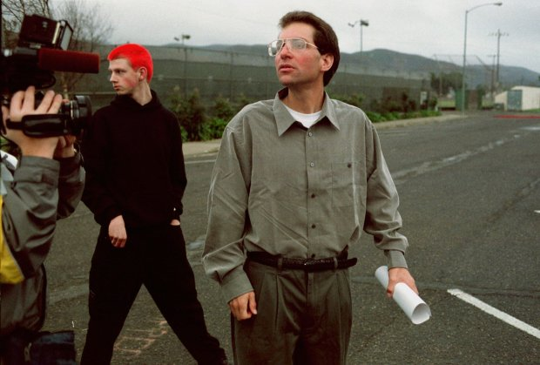
After another cybercrime, the court sentenced Mitnick to a year in prison and a compulsory course of treatment for "computer addiction”. Kevin was released on probation in 1990. As a basic condition, he was forbidden to use the computer. However, soon Mitnick again "joked": the number of the warden for his behavior was blocked. The judge's credit account was in complete chaos. All references to Mitnick's arrest and sentence have disappeared from the court's main computer. After that, he was declared wanted by the federal authorities. Of course, after a while he was caught again. While he was in prison, many books about him were published by various authors.

Slide 4

Gathering information
A lot of attention in the book is also paid to the collection of information. It would seem that so difficult in this? Gathering information is like building a house. If you try to start with the roof your house will surely be a failure. A good house will be built using a solid foundation and from there it will be built literally from the ground up. As you gather information you may be overwhelmed with how to organize and then use this data, so starting a file or an information gathering service to gather this data in is a good idea.

Slide 5

Elicitation
What is elicitation? Elicitation means to bring or draw out, or to arrive at a conclusion (truth, for instance) by logic. Alternatively, it is defined as a stimulation that calls up (or draws forth) a particular class of behaviors, as in “the elicitation of his testimony was not easy.”
Being able to effectively draw people out is a skill that can make or break a social engineer. When people see you and talk to you they should feel at ease and want to open up.
Strange as it may sound, but in a book about social engineering, there are many different psychological techniques including how to manipulate people.

Slide 6

Pretexting
Pretexting is form of social engineering in which an attacker tries to convince a victim to give up valuable information or access to a service or system. The distinguishing feature of this kind of attack is that the scam artists comes up with a story — or pretext — in order to fool the victim. The pretext generally casts the attacker in the role of someone in authority who has the right to access the information being sought, or who can use the information to help the victim.
Pretexting has a fairly long history; in the U.K., where it's also known as blagging, it's a tool tabloid journalists have used for years to get access to salacious dirt on celebrities and politicians. But today it's commonly used by scam artists targeting private individuals and companies to try to get access to their financial accounts and private data. And pretexters can use any form of communication, including emails, texts, and voice phone calls, to ply their trade.

Slide 7


